Slide 1




Summer Bootcamp on Deep Learning and its Applications
June 3rd - June 7th, 2024
June 10th - June 14th, 2024

Slide 2
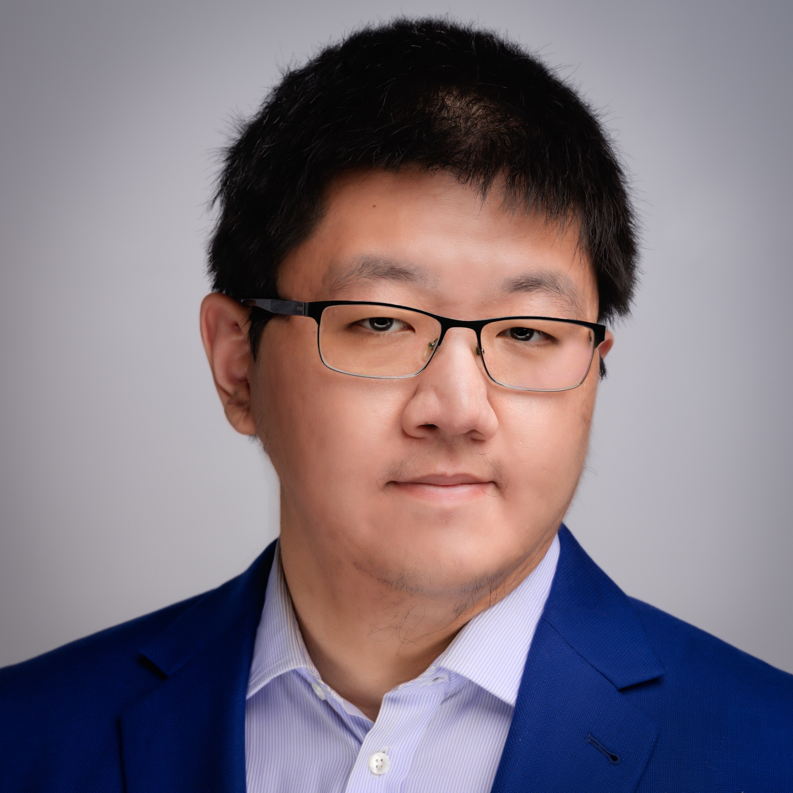
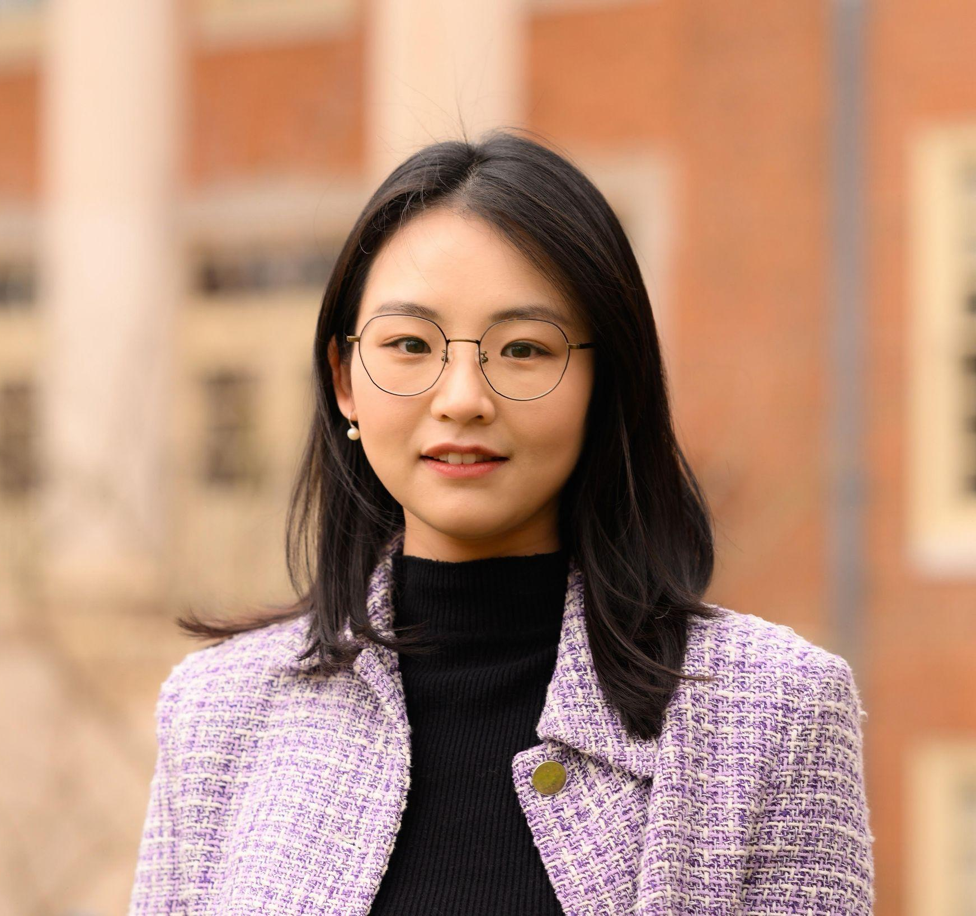
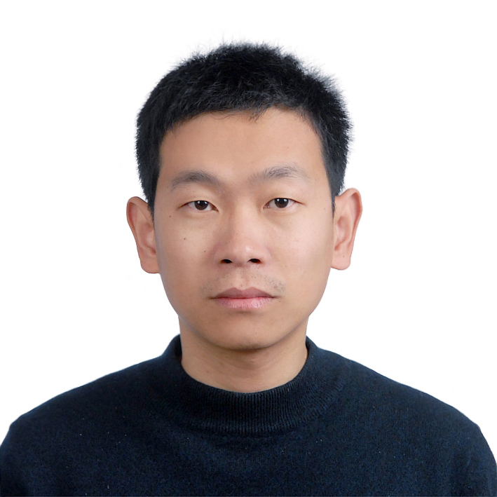
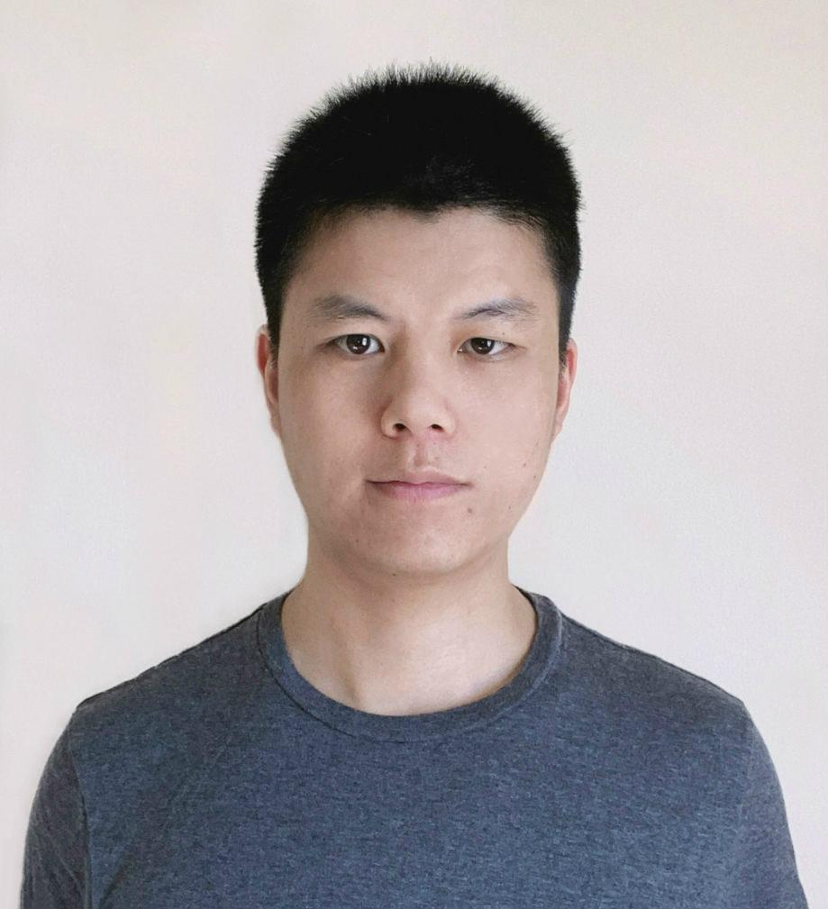
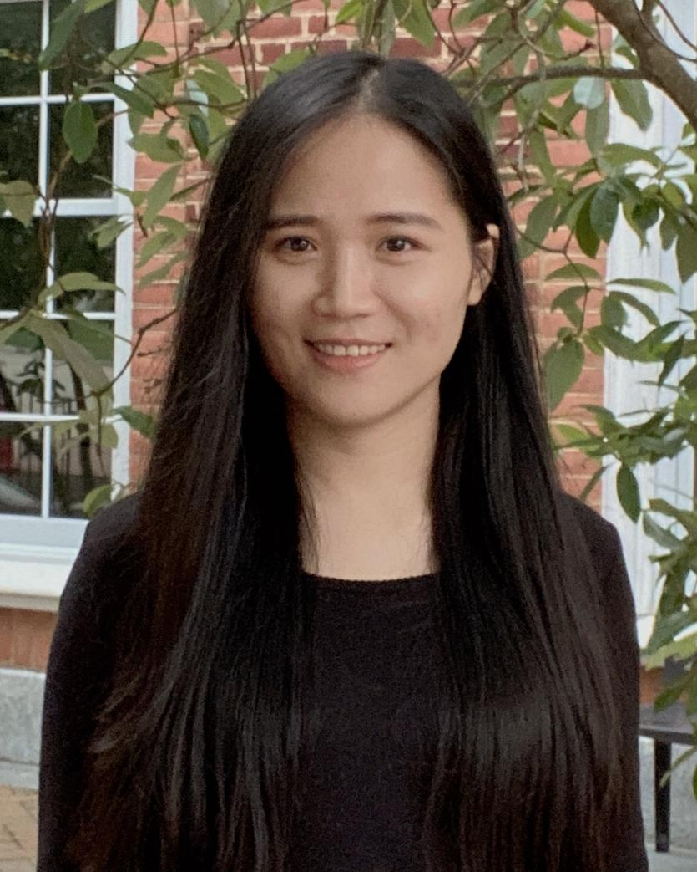
Organizing Committee
Aobo Li
Assistant Professor
Halıcıoğlu Data Science Institute
Department of Physics
Minghan Chen
Assistant Professor
Dept. of Computer Science
Wake Forest University
Huajie Shao
Assistant Professor
William & Mary
Chenglin Miao
Assistant Professor
Dept. of Computer Science
Iowa State University
Mengdi Huai
Assistant Professor
Dept. of Computer Science
Iowa State University

